Slide 1
CForce Corp Risk Management Matrix
GRC risk plan

Slide 2

What is CForce Corporation?
CForce Corporation is a logistic supply chain company that deals with the storing and transportation of freight, customer goods, and appliances.
Key Facts about CF
Handles over 100,000lbs+ of consumer shipments each day
Has a partnership with U.S. military nationwide
Conducts International shipping – via CANADA, CHINA, MEXICO, and more

Slide 3
CForce Management Analysis
FINANCIAL LOSS
DECREASED REPUTATION
CRIMINAL INVESTIGATIONS

Slide 4
Cforce Governing Hierarchy
Robert Rodgers President, CEO
[Adam Sharpe] Vice President
[Jerry Smith] Vice President
[Kim Won] Stakeholder
[Joe Ruso] Supervisor
[Mike Brown] Manager
[Molly K. Henry] Stakeholder

Slide 5
Let it become clear that Every organization, big or small must have a security plan in place.

Slide 6
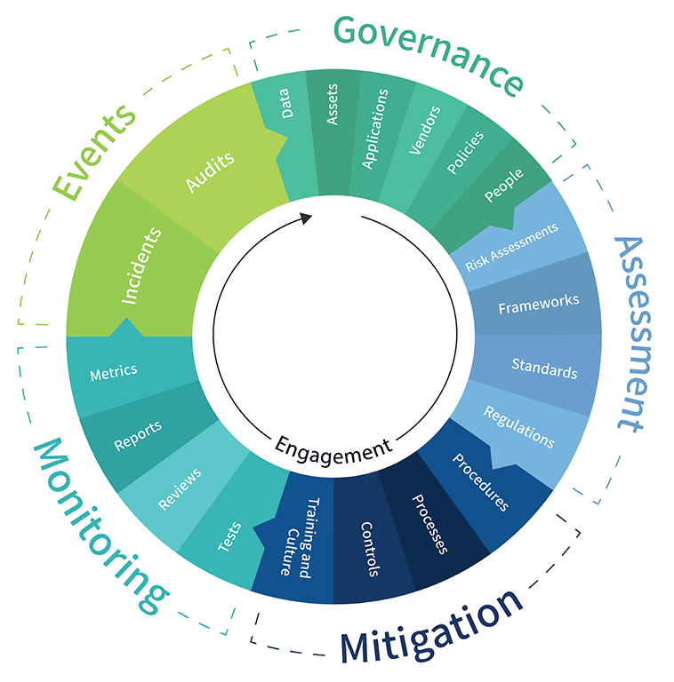
Risk Management Concept
The matrix is structured around the internal functionalities of Cforce Corp. This examination will focus on the organization’s current physical and technical status. At the conclusion of this internal assessment, the company will be able to effectively manage:
personnel
data
Policies
procedures
standards
inventory
technologies
Risk Management Lifecycle- Wheel

Slide 7

CForce CO Gap Analysis
Scope/Current State :
Cforce Corp has various weaknesses surrounding their physical infrastructure and overall business posture. The organization has inadequate governance/management practices, debilitated internal controls, absent ACS, and lacks recovery strategies from possible critical disasters. These gaps have led to operational disruption, large volumes of theft, unauthorized entry, insider breaches, and a possibility of comprised PII.
In addition, Cforce may not be completely compliant with U.S. regulations and standards.

Slide 8

CForce CO Gap Analysis
Goal/Desired State :
To restore the company to its highest levels of performance. Have a risk management lifecycle in place so that managers and IT members can routinely identify, assess, monitor, and control risks, associated with the organization’s continuity plan.

Slide 9
CForce CO Gap Analysis
Identified vulnerabilities/Gaps :
Weak governance structure
Inability to control and monitor personnel and visitors
Poor physical and technical access control systems
Physical infrastructure does meet regulatory standards
Poor maintenance of physical equipment
The IT team has failed to incorporate intrusion detection-based tools (SIEM, IDS, IPS).
Absent disaster recovery strategy
Difficulties with troubleshooting due to outdated backup systems

Slide 10
CForce CO Gap Analysis
Remediation plan :
Implement a foundational access control system to protect and assess physical and network security. (AAA Framework + CIA triad)
CCTVs and other physical metrics - gates, keys, ID readers, security personnel should be of top priority to reduce or eliminate theft and breaches. (24/7 Monitoring + Micro Management)
Security detection and event tools (SIEM’s, IDS/IPS) should be utilized and assessed daily. - System configurations.
Refined governance over policies, passwords, and accounts.
Security awareness training
Structured disaster recovery plan

Slide 11
CForce CO Gap Analysis
Review, Document, and Report :
The final step of the GA is to monitor, document, and report results to the governing hierarchy. Sharing a detailed report of the analysis, highlighting weak and strong points, modifications and implementations. In addition, a Q&A with management relating to the organizations risk appetite and residual risk.
What level of risk is the organization willing to accept in order to accomplish it’s objective? (Budget, downtime/loss of production, layoffs, etc.)
How confident is the company with its current controls? (Do they believe that adjustments are needed?)
Who is at the helm of communicating the importance of risk throughout the organization? (Employee training should be provided and acknowledged by all members of the organization – Managers, supervisors, team leads, base employees, etc.)

Slide 12
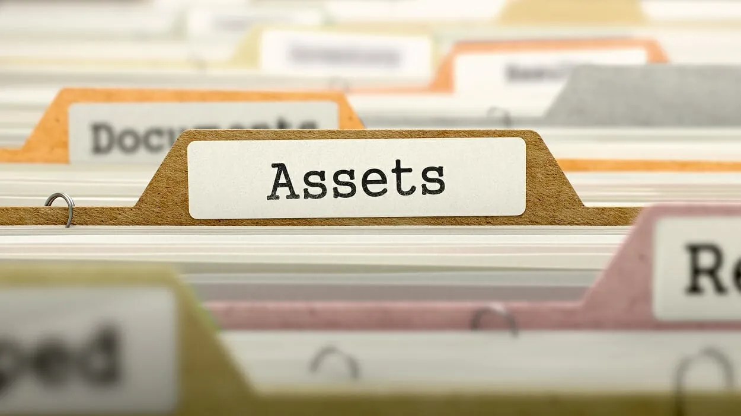
Cforce Corps Assets
List assets associated with the company are:
Personnel
Technology (Software and IT tools/systems)
Financial (Capital/Operational expense, stocks)
Physical (Infrastructure, Machinery, Trucks, Containers, Desktops/Laptops, Two-way radio, Tablets, Headsets, Cables, Servers, Documents)
Distribution
Promotion
Products (Customer Goods, Inventory)
Services (Account and Access Management, Third-party/Customer relationship)

Slide 13
Frameworks
Selecting and implementing the proper frameworks depends on the particular industry and the nature of the risk being evaluated.
NIST CSF
NIST 800-53
ISO/IEC 27035 – Information security Incident Management -ISIM
GDPR – Due to their practice in data protection
FEMA - National Disaster Recovery Framework
OSHA – Worker Safety and Health Resources for Hurricanes and Flood Recovery
OSHA 3220 -2004 – Warehousing Publication

Slide 14
Controls & Control Categories
Administrative/Managerial
Technical Controls
Preventative
Corrective
Physical/Operational Controls
Detective
Deterrence

